Slide 1

Parents’ Information Session September 2025

Slide 2
AIMS
INTRODUCTION
SETTING THE SCENE
AGENDA FOR THE YEAR
FORGING LINKS

Slide 3
School Vision
Learn to Love,
Love to Learn
At Kircubbin Integrated Primary School we firmly believe that we all need to love and be loved. Through core integrated principles of equality, faith and values, parental involvement and social responsibility we aim to ensure all within our school community are valued, respected and loved. In learning to love, our children can love to learn and achieve their full potential.

Slide 4
School Aims
Learn to Love,
Love to Learn
At KIPS we aim to create a loving, happy and stimulating environment where pupils can learn effectively by…
Equality
Catering for the needs of each individual.
Faith and Values
Ensuring that people from all faiths and none, are respected, acknowledged and accepted as valued members of the school community through mutual understanding.
Parental Involvement
Effectively partnering with parents and the wider community in supporting our children.
Social Responsibility
developing a sense of responsibility and a belief that we can all make a positive difference with ourselves and others, locally, internationally and to the planet.

Slide 5
SCHOOL APP
Information will be communicated primarily via the school app. This includes consent forms, absence forms and links to parent surveys/useful websites.
Please remember to sign up to P3 Message Group.
Click on Notifications and then Settings icon and Select P3 in Message Group.

Slide 6
SCHOOL MONEY APP
School is a cash-free zone.
Please download the app
The school money app will be used for processing payments for:
DINNERS - £2.60 – Remember to sign-up for Free School Meals if you’re entitled. Even if you are not using it regularly it makes a difference to the money school is allocated.
WRAP AROUND CARE (including bookings)
AFTER-SCHOOL CLUBS
TRIPS
HEALTHY SNACK

Slide 7
ADMINISTRATION
The following is sent home with your child at the start of the school year. Please complete and return as soon as possible.
PERMISSION LETTERS
MEDICAL INFORMATION
COMMUNICATION- CONTACTS UPDATED IF NECESSARY
DATA CAPTURE FORMS

Slide 8
Medical Administration/ Special Diet
A signed administration form is required for all medications given in school (including inhalers).
Forms available from school website, class teacher and the school office.
If you would like your child to have a canteen dinner and they have any special dietary requirements it is essential that you complete a Special Diet Medical Form and return it to the office asap.

Slide 9
DATES FOR YOUR DIARY
Parental Consultations–
20-24 October 2025
23 February – 27 February 2026
We will be encouraging face to face meetings. Phone calls may be arranged if preferred.

Slide 10
DATES FOR YOUR DIARY
KIPS After School Clubs Dates 2025/26
Dates and details of clubs will follow shortly.
Term 1 clubs will commence week beginning 29th September. (P1 clubs will start in Term 2).

Slide 11
COMMUNICATION
Contact the office to:
Inform class teacher of any changes to collection arrangements (bus etc.)
Inform teacher of illness (or via school app).
Inform school of any changes to personal details.
Arrange an appointment or phone call with a class teacher.
Inform school if you require dual communication.

Slide 12
COMMUNICATION
Pastoral Care is of the utmost importance to us.
Please inform us about any change in circumstances that could be impacting on your child.
Such as -
Parents away on holiday/ working away
Family bereavement
Moving home
Change in relationship status of parents/carers

Slide 13
Attendance
It is important that your child is in school whenever possible. If your child is suffering from vomiting/diarrhoea symptoms it is recommended they remain at home until 48 hours after symptoms have ceased.
Parents will receive a letter home informing them if their child’s attendance has fallen below the EA target of 90% (more than one day every four weeks). The Education Welfare Officer will also track any attendances that fall below this percentage.
Any child arriving in school after 9.05am will be recorded as late. It is important for your child to be there at the beginning of the school day.
Holidays in Term Time
Holidays during term time are discouraged by the school. Parents are reminded of the effect that absence can have on a pupil’s potential achievement. Class work will not be sent home.

Slide 14








Attendance
Absence Tiers
Tier 3
Severe Chronic Attendance
Pupils with 20%+ absence
(4+
days per month
)
Tier 2
Chronic Attendance
Pupils with 10%
-
19.9
% absence
(2
-
3
days per month
)
Tier 1b
At Risk Attendance
Pupils with 5%
-
9.9
% absence
(1
-
2
days per month
)
Tier 1a
Regular Attendance
Pupils with 0
-
4.9
% absence
(<1
day per month
)

Slide 15
Drop Off/Collections
Learning to Love,
Loving to Learn
Drop-off arrangements remain the same - No pupils to be in school before 8.45am.
All pupils should be left off at the main entrance where they will be directed to their classroom.
Parking is only available for P1 parents or as agreed in other exceptional circumstances.
Staggered pick-up times.
Offsite parking is recommended where possible (to avoid congestion).
Pick-up for P3- 2pm at the side door.
Please let us know as soon as possible if there are any changes to arrangements (going to be late, different person, bus, etc.)

Slide 16
HEALTH AND WELL-BEING
MyHappyMind
Mood tracker
Bubble Time
Circle Time
Daily Mile

Slide 17
IMAGINE IF
Learn to Love,
Love to Learn
As a school we recognise the benefit of our weekly counselling sessions and have decided to continue with the service at a cost to the school.
This will consist of two weekly school counselling sessions providing support to two individual pupils each half-term.
If you feel that your child would benefit from these sessions please complete a referral form online https://imagineif.org.uk/primary-schools

Slide 18
HEALTHY EATING
As a school we promote healthy eating and a balanced diet. Please note the following –
HEALTHY BREAK- Please pay this through the School Money App. We no longer accept cash.
Nut free zone (please do not send any birthday cakes into school for sharing). We have a number of pupils in our school with serious nut allergies.
Water bottles (should contain water only – advice from dentist).
Items such as crisps, sweets and chocolate should be kept to a minimum as treats (preferably none).

Slide 19
KIPS +
KIPS+ is the name of our school Parents’/Teachers’ Association (PTA).
If you would like to be involved please phone the school office for further details.

Slide 20
CLASS INFORMATION
Miss Smyth will be the P3 Teacher on Monday and Tuesday.
Mrs Downes will be the teacher on Wednesday, Thursday and Friday.
2 classroom assistants- Mrs Adair and Miss McMaster.
28 children in P3. Due to GDPR we cannot send home class lists.
Pupils may arrive from 8.45. P3 School day starts at 9am and ends at 2pm.
Assembly-we celebrate achievements. Pupils may bring in medals/certificates from outside events.

Slide 21
SCHOOL EQUIPMENT
Bringing resources to school:
On a daily basis your child should bring:
Packed lunch (if applicable)
Filled water bottle (water only)
Book bag
Wellies (to leave in school)
A coat
Please remember to label all items of clothing.
Over the ear headphones- send in, when you’re able to, labelled headphones. These will stay in school for individual iPad use.
Toys/fidgets should not be sent in to school (unless approved through approved through consultation with school). School can provide these as necessary.
Please make sure where possible items are labelled clearly with your child’s name.

Slide 22
LANGUAGE AND LITERACY
Guided Reading
Your child’s reading record and guided reading book/books will be sent home each night. Please ensure your child brings them to school each day so they are able to complete their guided reading in class.
Writing
Writing: Each half term has a specific focus when it comes to writing.
You will be able to see your child’s writing when books go home.
At this stage in P3, what we are looking for in your child’s writing:
Capital letters, full stops and finger spaces.
Neat writing/consistent letter formation.
Increasingly spelling more common words correctly.

Slide 23
Accelerated Reader Video

Slide 24
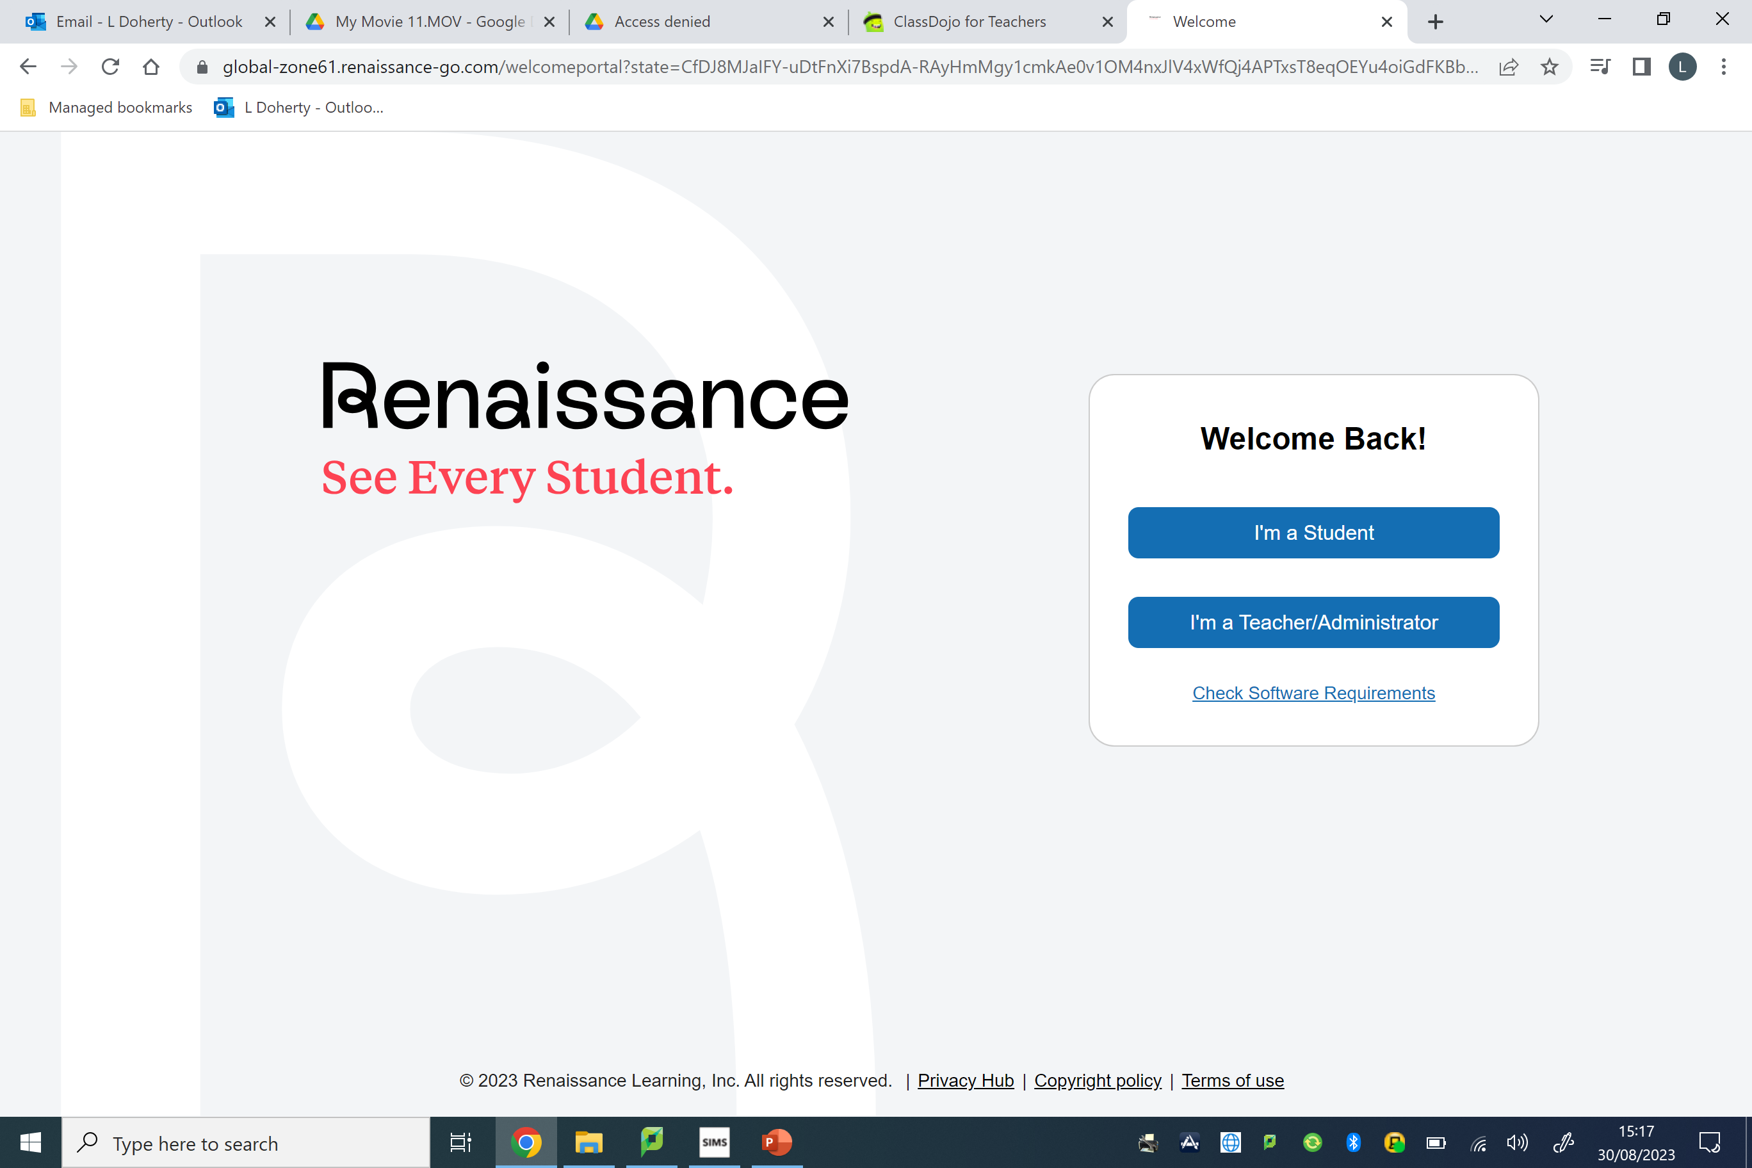
How to Sign up for Notifications

Slide 25
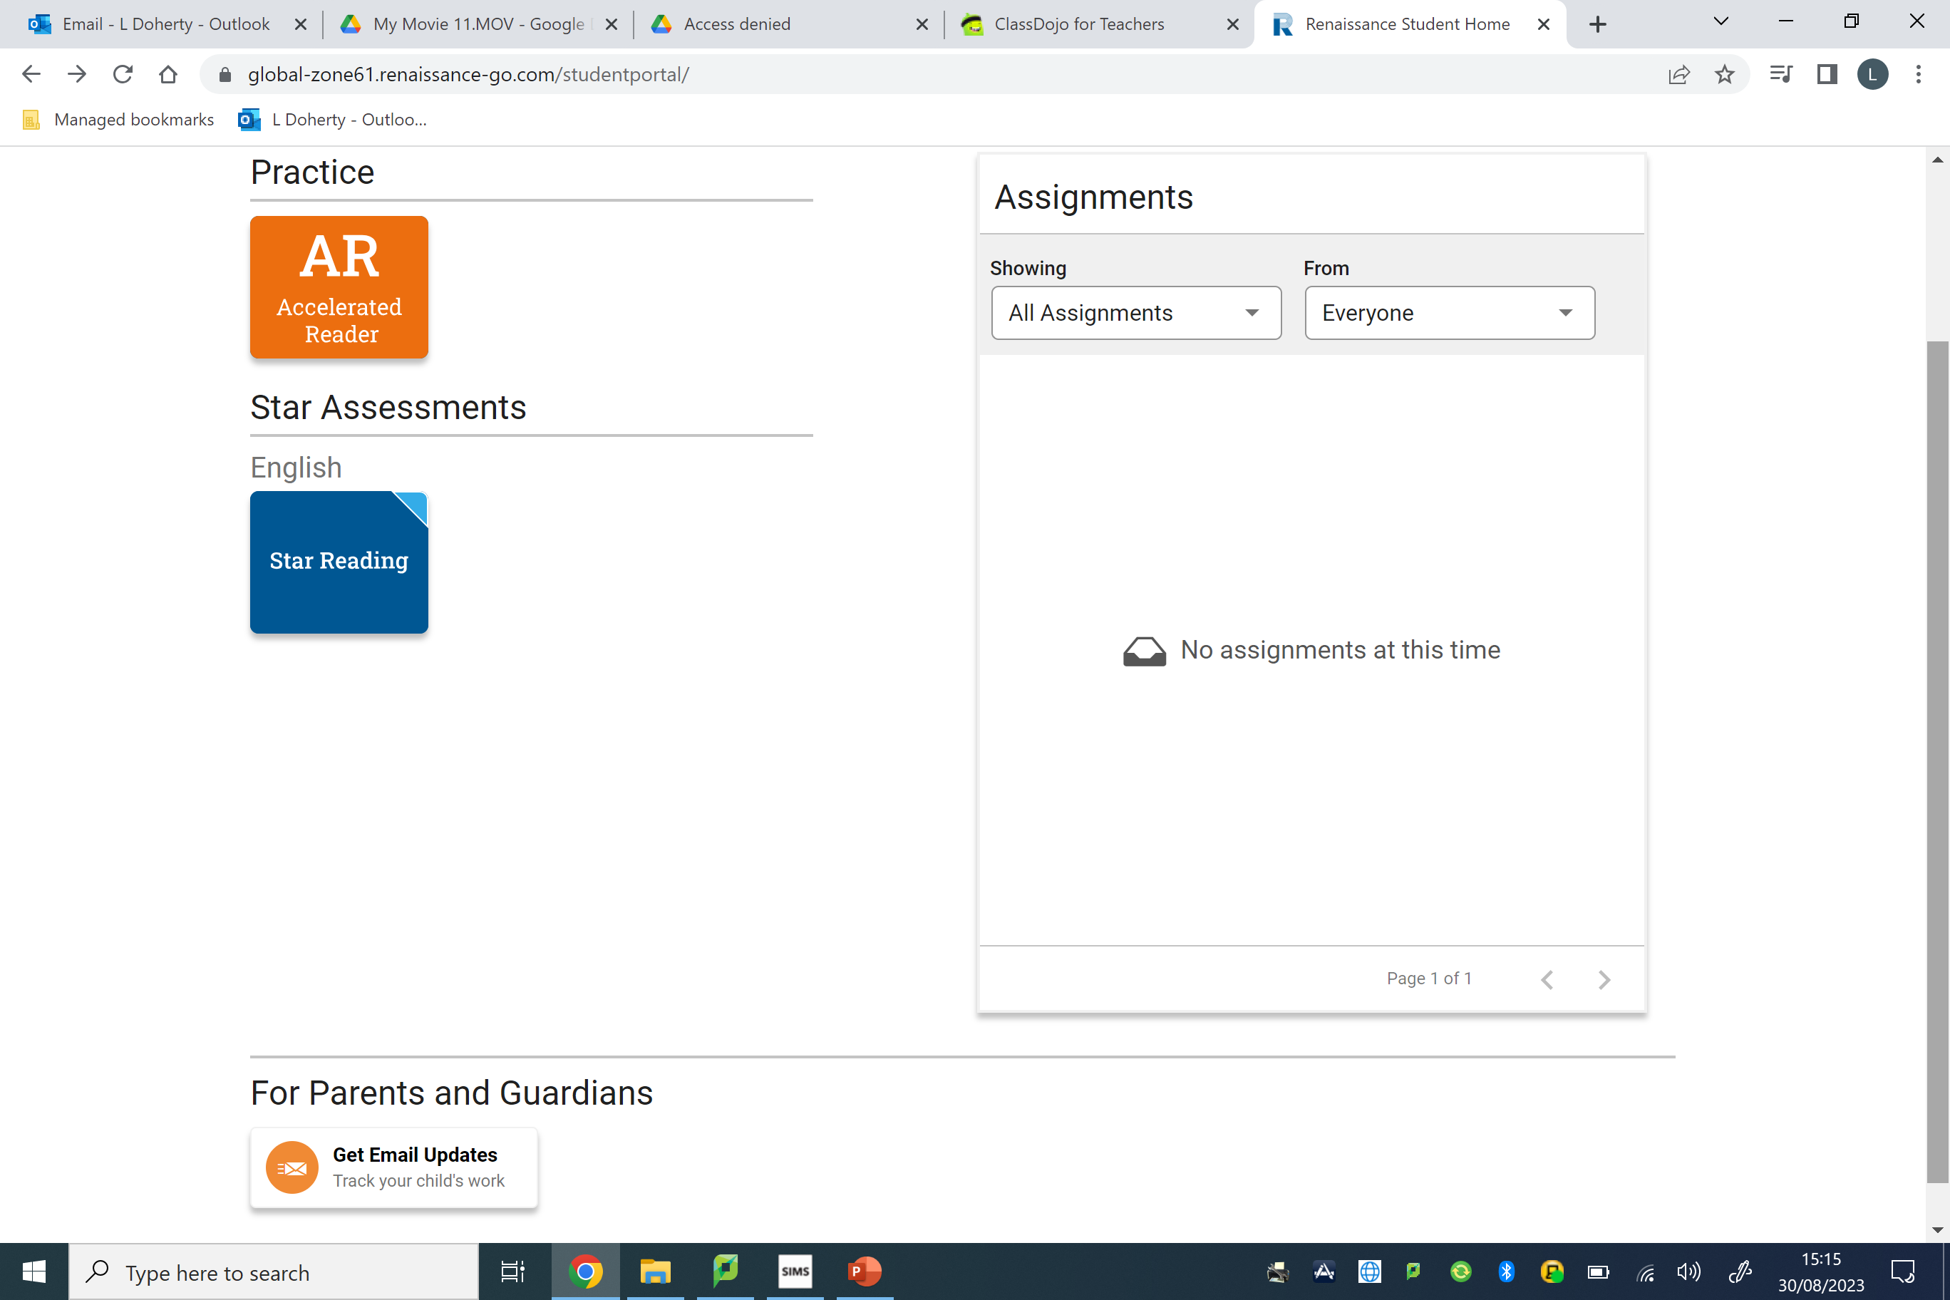
How to Sign up for Notifications

Slide 26
ACCELERATED READER P3-7
P3 is the first year of Accelerated Reader for pupils.
Pupils complete a STAR READER test. This gives pupils a score and a corresponding box that they choose from.
Books chosen are at your child’s level.
Please encourage reading as much as possible. When they have finished their book they take a quiz.
Pass a quiz = sticker on bookmark
10 stickers = prize from prize box

Slide 27
ACCELERATED READER P3-7
Pupil targets – child specific and achievable. Targets set throughout the year (approx. every 8-9 weeks). All pupils are expected to meet their target.
STAR Test.
AR letters will be sent home to parents of any pupil achieving under 75% of their target.
The number of targets reached at the end of the year will be recorded on the annual report.

Slide 28
SDP Focus
Learn to Love,
Love to Learn
As a result of an increase in the percentage of children meeting their AR targets we now have a higher percentage of children reading a year or more ahead of their actual age and a significant decrease in the percentage of children reading behind their actual age.
Example of the impact regularly meeting your AR target has throughout a year:
Pupil A met all 5 reading targets with significant improvements in their reading while Pupil B didn’t meet any of their reading targets. The difference between the two pupils reduced from 2 years and 4 months to 2 months in one academic year.
Pupil A | 6 years 8 months | 7 years 7 months | 8 years 1 month | 8 years 3 months | 9 years 2 months
Pupil B | 9 years | 9 years 2 months | 9 years 7 months | 9 years 5 months | 9 years 4 months

Slide 29
USING MATHS
Numeracy in P3
We cover number, money, shape, measures and handling data.
Number - Begin with numbers within 20. This includes Number Stories, consolidation of numbers to 20, adding/subtracting to 10 and then 20.
As the year progresses we cover numbers and processes to 30, 50 and then 100, including vertical and horizontal addition to 100.
Mental Maths- Counting in 2’s, 5’s and 10’s from any given number.
Number Story - A number story is a given number and all of its addition and subtraction facts that can be generated.
A specific number story will be covered each week in class. You will see this in your child’s weekly tables.
You could leave out a different missing number when practising at home.
Encourage quick recall of facts.
This will really help your childs' mental maths skills.
P3 will begin Freckle Maths in the Summer Term.

Slide 30
TOPICS
Autumn 1 and 2 – Safe and Sound
Spring 1 – Whatever the Weather
Spring 2– Bugs. Birds and Beasts
Summer – Houses and Homes

Slide 31
ASSESSMENT
PTE/PTM STANDARDISED TESTS (every May)
CLASS ASSESSMENTS- Weekly Friday tests
Comments in books
AR STAR TESTS (every 9 school weeks approx)
Books will be sent home to parents (half-termly) to be signed

Slide 32
Rewards
Class rewards
Class Dojo- earn points and the winner awarded certificate and prize.
Table points- Weekly prize for the table.
Pupil of the Week- awarded in assembly.
Pupil Code of Conduct-displayed in classes and created by Student Council.
Class Charter created with class in first week by using UN Convention on the Rights of a Child.

Slide 33
SDP Focus 2025/26
One area of our School Development Plan for this year will be focusing on Well Being. Part of this will be introducing our word for the year -
POSITIVITY (bookmark)

Slide 34
Homework
Starting from Monday 8th September (Reading this week)
Written homework begins 15th September.
Please sign homework when it is completed.

Slide 35
Homework
Learn to Love,
Love to Learn
P3 Homework consists of:
Given out at the start of the week.
Numeracy and Literacy homework (to be completed for Thursday).
Spellings- look/cover/write/check. To be completed each night and returned to school each morning. Monday – Wednesday- copy each spelling out twice. Copy tables once.
Thursday – complete a revision of the spellings for the week by selecting some words from each night.
Tables- Completed each night and returned to school each morning.
Reading- Guided Reading book will be sent home at the start of the week. Some groups will have 2 books. Another book will go home on a Wednesday.
Encourage pupils to take pride in all their work, including homework.
Please sign homework when it is completed.
Every Friday pupils will be tested on their spellings and tables for the week.

Slide 36
Homework Completion
Homework Completion is monitored and recorded each week. This includes spellings, tables and reading. This will be recorded on your child’s annual report in June.

Slide 37
Homework
Titles / Year Groups | 1 | 2 | 3 | 4 | 5 | 6 | 7
Time Spent per night | Up to 20mins | Up to 20mins | Up to 25-30mins | Up to 25-30mins | Up to 30-40mins | Up to 40-45mins | Up to 40-45mins
Spellings | N/A | N/A | Daily (learning and written) | Daily (learning and written) | Daily (learning and written) | Daily (learning and written) | Daily (learning and written)
Guided Reading/ Accelerated Reader | As reading emerges, Reading 4 nights | Reading 4 nights | Reading 4 nights (15mins) | Reading 4 nights (15mins) | Reading 4 nights (20mins) | Reading 4 nights (20mins) | Reading 4 nights (20mins)
Written | Literacy/Numeracy (To include topic related homeworks) |  | Literacy/Numeracy (To include topic related homeworks)
Learning | Reinforcement of letters, words and numbers | Sounds and tricky words | Tables | Tables | Tables | Tables | Tables

Slide 38
Homework- Parental Involvement
How you can support your child:
Encouraging your child to complete their homework.
Checking and signing completed homework.
Encouraging a love of reading (reading to/reading with your child, questioning your child about what they’ve read etc.)
Establishing a homework routine
Creating the right environment- E.g. Removing distractions, technology, setting aside designated time etc.
Rewards at home?

Slide 39
Internet Safety
Many children are using video sharing platforms, social media and messaging apps such as:
Whatsapp , Snapchat, Tiktok, etc. (age 13+). These platforms are not suitable for primary school children.
Online gaming; eg, Fortnite (age 13+)
Youtube (set age limit profiles)
Issues can arise when using these apps. It is so important to monitor what your child does online. As a school we believe it is much safer for your child if they are not on these platforms (age restrictions).
You can download the ‘Safer Schools NI’ app for guidance on parental controls, making devices safer and how these apps are used.

Slide 40
PE
PE- all pupils will be required to wear outdoor games kit (white polo shirt, black/red shorts and/or black tracksuit bottoms/leggings, red hoodie/quarter zip and trainers) for the whole school day.
Please clearly label anything they will wear into school.
From week beginning 2nd September.
P3 PE will be taken by Miss Smyth every Wednesday.
Just a reminder that PE hoodies must only be worn on PE days. Full uniform must be worn every other day.

Slide 41
HOW YOU CAN HELP
Look over classwork books when they are sent home.
Keep in touch with any issues you feel we should know about.
Support with homework- reading, completing all parts of homework.
Check homeworks and sign.
Notes to teacher clearly labelled, include the date.
Any changes to bus days please inform the school.
Encourage Independence
In class we are encouraging independence.
You could encourage this at home e.g. allow your child to pack their own school bag.
Encourage them to have a go at their homework on their own.
Encourage them to check if they have packed their reading book, homework folder and spellings and tables book.
Resilience
We encourage resilience in P3 so your child knows:
It’s good to have a go or have a try yourself.
It’s ok to make mistakes.

Slide 42
We are really looking forward to getting to know your child and we hope they have a great year in P3. ☺
Any questions?

