Slide 1

Information Session September 2026
"Learn to Love, Love to Learn"
At KIPS we aim to create a loving, happy and stimulating environment where pupils can learn effectively.

Slide 2
School Day
8:45 am | School doors open. Children should walk to their classrooms independently to encourage resilience.
9:00 am 9:05 am | School day starts. Punctuality is essential as we establish routines immediately. Late mark is officially recorded on the register. Any late arrivals must enter through the main reception.
3:00 pm | End of school day. Staff will escort children to the collection point.
PE Day: Wednesday
Swimming Day: Thursday (Term 1)
Drop-off: All children should be dropped off at the main entrance where they will be directed to their classroom.
- Parking is only available for P1 parents or as agreed in other exceptional circumstances.
- No child should be unsupervised onsite before 8.45 am or after collection times.
Collection: P6 will be collected from the main entrance.
- To ensure a safe handover; we ask that parents/carers get out of their vehicles to collect their children.
- Please inform the school office of any changes to collection arrangements.
Bus: Please inform the school office of any changes to bus arrangements.
Walking home: Written consent must be given to the office.

Slide 3
Curriculum Areas
Literacy
Numeracy
World Around Us
Spanish
PE
Music
ICT
PDMU
Diversity and World Religions
Trips
We aim to provide a range of educational visits and trips throughout the year to enhance pupils’ learning experiences.
Viking Museum 8th December 2026.
After School Clubs
We provide a wide range of After-School Clubs each term.
Further information will be shared via the school app.
Pupil Support
Numeracy/Literacy
Reading Partnership
Social Group
Parents/Carers will be informed if their child is accessing support.
Assessments
- PTE/PTM STANDARDISED TESTS (every May)
- CLASS ASSESSMENTS- Weekly Friday tests
- STAR Reader/Maths (every 9 school weeks approx)
- Books will be sent home to parents (half-termly) to be signed

Slide 4
Homework Completion is monitored and recorded each week.
This will be recorded on your child’s annual report in June.
Homework
Homework sheets are issued on Monday and collected on Thursday.
Homework tasks officially begin on Monday 7th September (Reading for the first week).
Holidays during term-time are highly discouraged - School policy dictates that class work/homework will not be sent home for holiday absences.
Titles / Year Groups | 1 | 2 | 3 | 4 | 5 | 6 | 7
Time Spent per night | Up to 20mins | Up to 20mins | Up to 25-30mins | Up to 25-30mins | Up to 30-40mins | Up to 40-45mins | Up to 40-45mins
Spellings | N/A | N/A | Daily (learning and written) | Daily (learning and written) | Daily (learning and written) | Daily (learning and written) | Daily (learning and written)
Guided Reading/ Accelerated Reader | As reading emerges, Reading 4 nights | Reading 4 nights | Reading 4 nights (15mins) | Reading 4 nights (15mins) | Reading 4 nights (20mins) | Reading 4 nights (20mins) | Reading 4 nights (20mins)
Written | Literacy/Numeracy (To include topic related homework) |  | Literacy/Numeracy (To include topic related homework)
Learning | Reinforcement of letters, words and numbers | Sounds and tricky words | Tables | Tables | Tables (Term 1) Daily Practice (Math/Eng) – Term 2/3 | Daily Practice (Math/Eng) | Daily Practice (Math/Eng)
What to expect:
- Literacy
- Numeracy
- Reading
- Freckle
Daily Spellings
- Daily Practice (Maths/English)

Slide 5
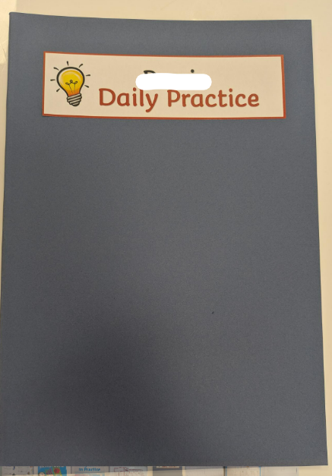
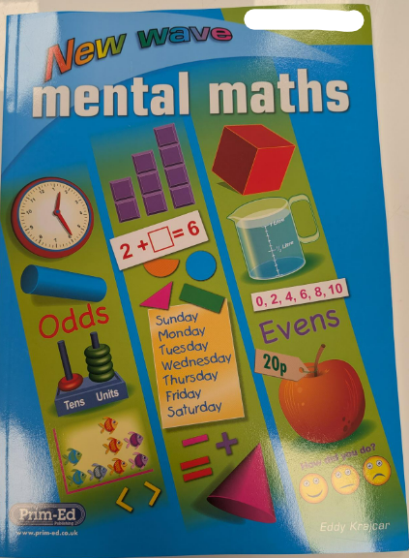

What is Daily Practice?
Homework – P6/7
This year, Daily Practice will replace tables homework.
Children will complete a short Maths and English activity each night from Monday to Thursday, consisting of approximately 10-20 quick questions.
We feel this homework will be beneficial as it provides regular repetition and revision of key concepts, helping to build confidence and reinforce learning in a manageable way.
Children will receive:
A Daily Practice Exercise Book to record their answers.
A New Waves Mental Maths textbook.
A New Waves English in Practice textbook.
The Exercise Book should be brought to school every day, along with spelling homework, as work will be marked each morning as a class.
Please do not write in either textbook. These books will be collected at the end of the year and should be kept clean, tidy and in good condition.
The textbooks should remain at home each day.

Slide 6
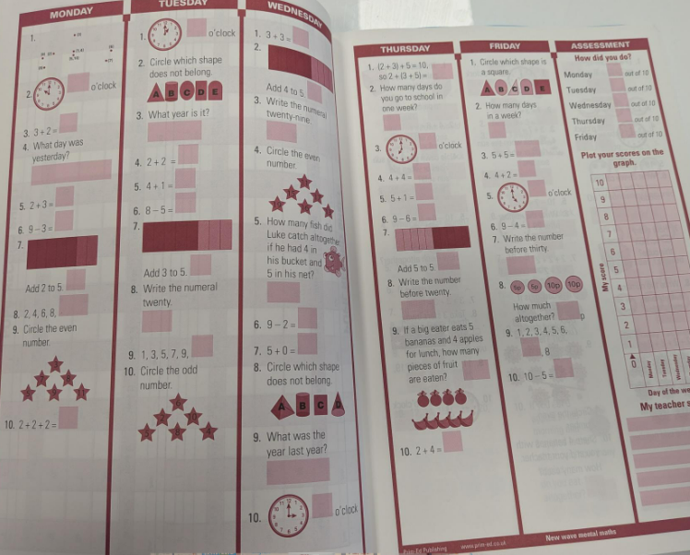
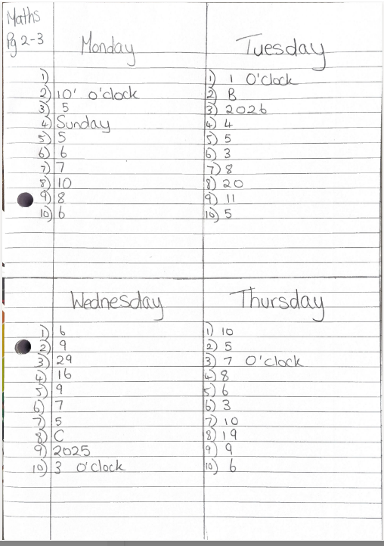
Homework – P6/7
New Waves Mental Maths Homework
Children will complete their Waves Mental Maths homework each evening from Monday to Thursday.
Friday's activity will be completed in school.
Please DO NOT WRITE in the Waves textbook.
All answers should be recorded in your child's Daily Practice Exercise Book.
Children should divide one page into four sections (using a ruler) and clearly label each section: Monday, Tuesday, Wednesday and Thursday.
Write the page number/maths in the top left-hand corner of each box.
Answers should be presented neatly and clearly. There is no need to write out the questions.
Any questions that require children to draw, colour or write in the textbook should be skipped.
Layout

Slide 7
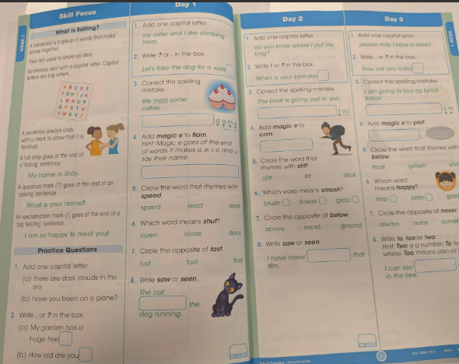
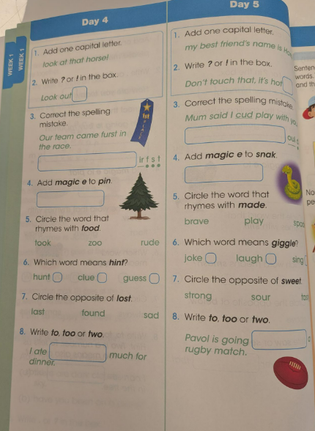
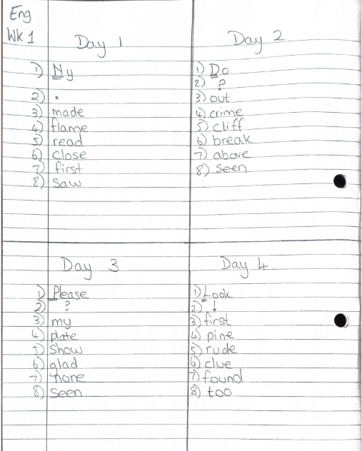
Homework – P6/7
New Waves English in Practice Homework
Children will complete their New Waves English homework each evening from Monday to Thursday (Day 1- 4)
Day 5 will be completed in school.
Please DO NOT WRITE in the New Waves English workbook.
All answers should be recorded in your child's Daily Practice Exercise Book.
Children should divide one page into four sections (using a ruler) and clearly label each section: Day 1, Day 2, Day 3 and Day 4.
In the top left-hand corner, children should write Eng, followed by the week number (e.g. Eng - Wk 1).
Answers should be presented neatly and clearly. There is no need to write out the questions.
Children should read the Skill Focus section each week for guidance and revision of the key spelling and language concepts being taught.
The Practice Questions do not need to be completed.
Layout

Slide 8
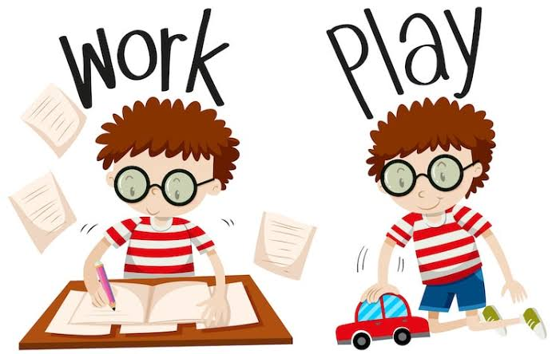
Homework – How can you support your child?
Environment: Establish a quiet homework environment free from screens and technology distractions.
Routine: Establish a consistent homework routine.
Support: Support your child with homework by offering guidance and accessing helpful resources when needed, while also encouraging independent thinking.
Encouragement: Use praise and appropriate rewards to motivate and celebrate effort and achievement.
Reading: Promote a love of reading through shared reading and discussion.
Signature: We ask that parents/guardians actively check and sign homework each night once tasks are completed.

Slide 9
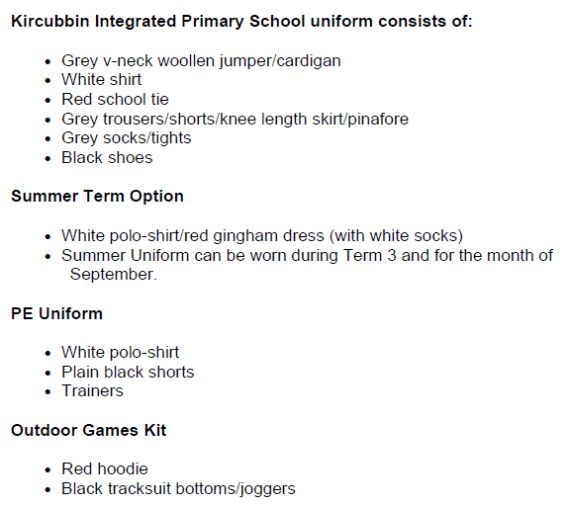
Uniform and Equipment
Uniform
- PE kit must only be worn on PE/swimming days.
Full uniform must be worn every other day.
Please refer to our school uniform policy
Daily Equipment
Healthy snack (P4-7)
Packed lunch (if applicable)
Filled water bottle
Coat
Over-the-ear headphones (labelled) to stay in school for individual iPad use.
Label Everything - All items (coats, jumpers, PE gear) should be clearly labelled with your child’s full name to prevent losses.
Toys/fidgets should not be sent into school (unless approved through consultation with class teacher).
Each class has a sensory box within the classroom.

Slide 10
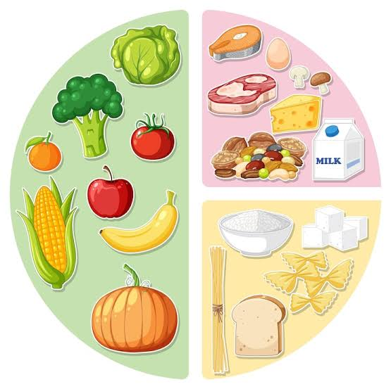

Healthy Eating
As a school we promote healthy eating and a balanced diet.
Water bottles should contain water only.
Items such as crisps, sweets and chocolate should be kept to a minimum.
We are a ‘Nut Free Zone!’
- We have a number of pupils with serious nut allergies, so please take care when packing snacks and lunches and do not send any items containing nuts into school.
- Please do not send any birthday cakes into school for sharing..

Slide 11



Pastoral Care and Mental Well-Being
MyHappyMind
Mood tracker
Bubble Time
PDMU Lessons/Circle Time
Daily Mile
Celebrating Success: Pupils' achievements, including medals, certificates and trophies earned outside school, are celebrated during our weekly Monday assemblies.
As a school we recognise the benefit of our weekly counselling sessions.
If you feel that your child would benefit from these sessions, please complete a referral form. These can be accessed from the ‘imagineif’ website.
imagineif.org.uk/primary-schools

Slide 12
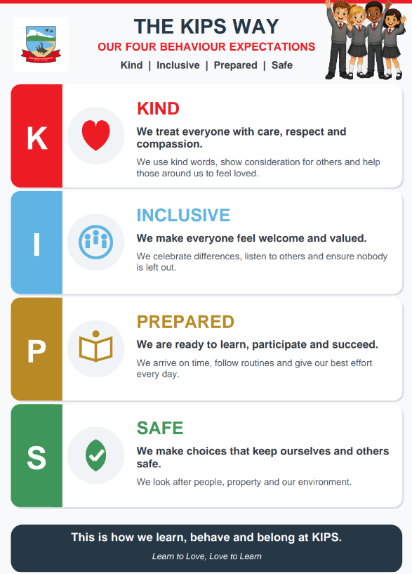
Our 4 Behaviour Expectations
This year we are introducing The KIPS Way, built around our four key behaviour expectations:
Kind, Inclusive, Prepared and Safe.
These values underpin how we learn, behave and belong at KIPS.
By working in partnership, we hope to ensure that the children understand these expectations and consistently demonstrate them in their daily lives.

Slide 13
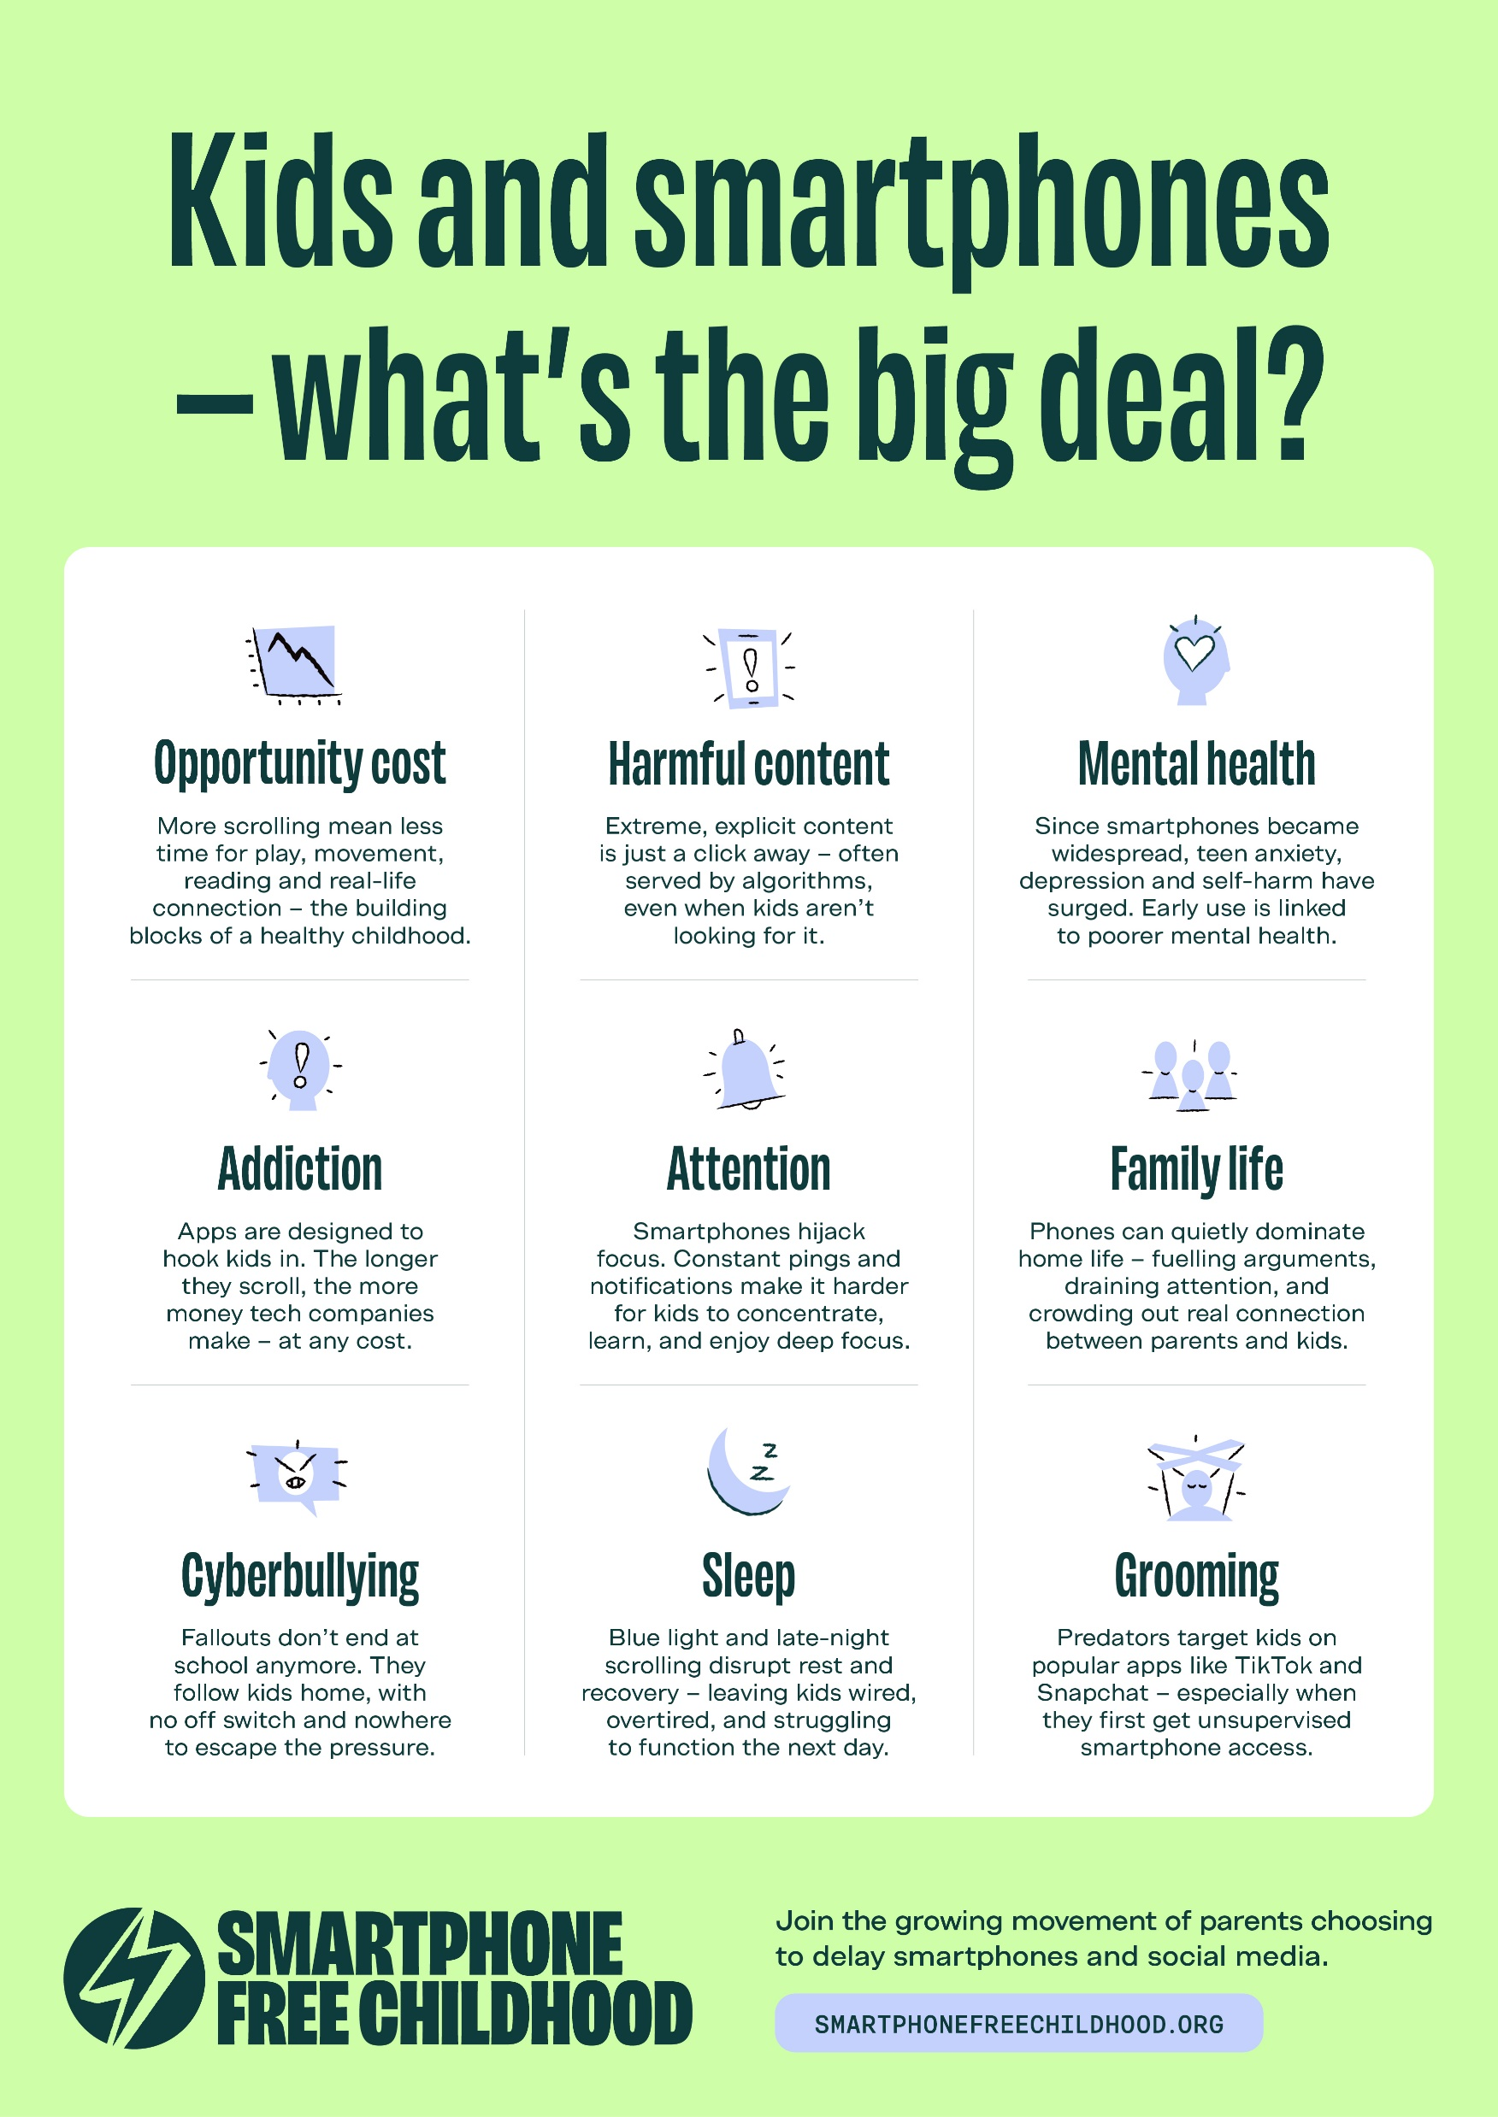

Internet Safety
Many popular apps and online games, including WhatsApp, Snapchat, TikTok and Fortnite, have age restrictions and are not designed for primary school-aged children.
Issues can arise when using these apps.
- As a school, we encourage families to follow age ratings, use parental controls and regularly monitor their child's online activity.
The Safer Schools NI app provides helpful guidance on online safety, parental controls and the latest apps and games used by children.

Slide 14
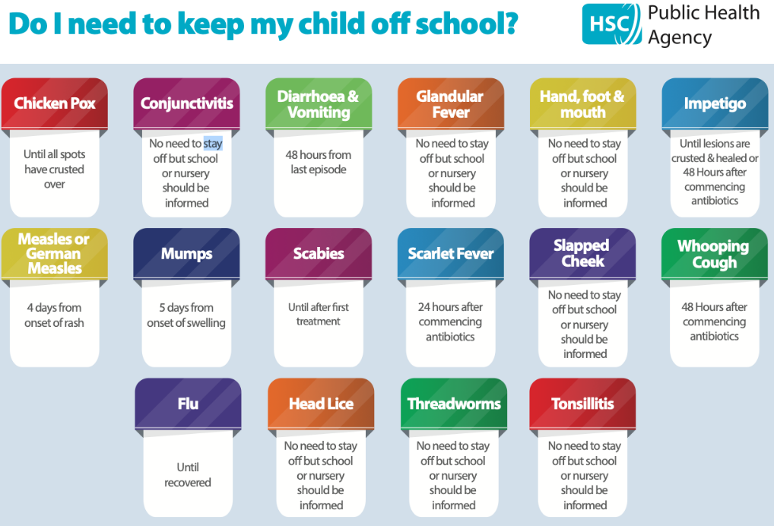
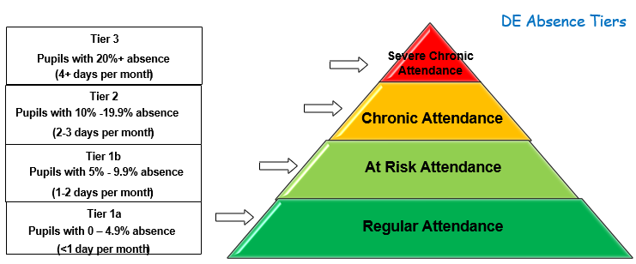
Attendance
Regular attendance is essential for your child's learning and progress.
Holidays during term time are discouraged as absence can impact learning and achievement. Classwork will not be provided for holidays taken during term time.
- Children should remain at home until 48 hours after vomiting or diarrhoea symptoms have stopped.
- Parents will be informed of attendance levels at Parent Consultations.
Attendance below 90% may be monitored by the Education Welfare Officer.
(90% attendance equals approximately one month of lost learning each school year).
Please report reason for absence on School App or via School Office!

Slide 15
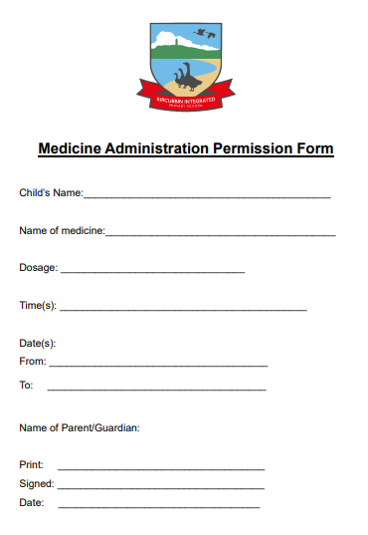
Essential Forms
The following is sent home with your child at the start of the school year. Please complete and return as soon as possible.
PERMISSION LETTERS
MEDICAL INFORMATION
COMMUNICATION- CONTACTS UPDATED IF NECESSARY
DATA CAPTURE FORMS
Medical Administration
A signed medication form is required for any medication administered in school, including inhalers.
Forms are available from the school office, class teacher or school website (see administration of medicine policy).
Special Diet
If your child requires a special diet and will be having school dinners, please collect a Special Diet Medical Form from the school office and return it as soon as possible.

Slide 16
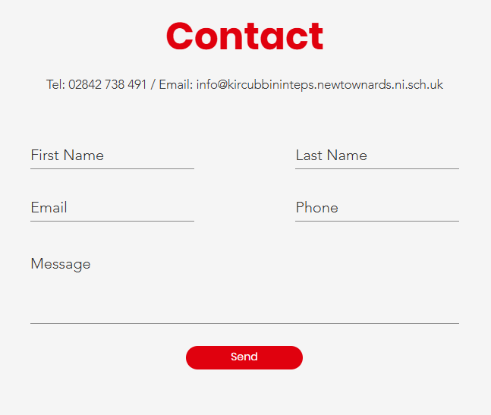
Communication
We value strong home-school partnerships and encourage open communication throughout the school year.
Contact the office to:
Inform the class teacher of any changes to collection arrangements.
Report absences or illness (or via the school app).
Inform the school of any changes to personal details.
Request dual communication.
Arrange an appointment or phone call with a class teacher.
Please be mindful that the beginning and end of the school day are busy times when staff are focused on welcoming pupils into school and ensuring they are safely dismissed.
If you need to pass on information or discuss a concern, please contact the school office or arrange a suitable time to speak with your child's teacher.
Important ‘Dates for the Diary’ are included on our ‘Weekly Updates’.
We encourage pupils to develop independence and confidence by speaking to their teacher about everyday matters, including friendships, forgotten homework, missing items and any difficulties they may be experiencing in school.

Slide 17
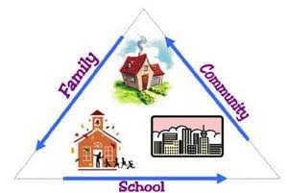

How can you get involved in School Life?
We believe parents/carers are a vital part of our school community and we love welcoming families into school life.
There are many ways you can contribute, including:
Sharing information about your job or career
Reading with children
Supporting gardening projects
Sharing a skill, hobby or area of expertise
Helping with educational visits, events and special activities
We greatly value the knowledge, talents and experiences that parents/carers can bring to enrich our pupils' learning.

Slide 18

How can you get involved in School Life?
If you are interested in joining KIPS+, please contact the school office.
KIPS+ is our Parents' and Teachers' Association and plays a vital role in school life.
By joining KIPS+, you can help to:
Support school events and activities
Raise funds for resources and opportunities for our children
Strengthen connections between home and school
Help build a strong and welcoming school community
Whether you can help regularly or occasionally, every contribution is valued and appreciated.
We would love to welcome new members and fresh ideas.

Slide 19
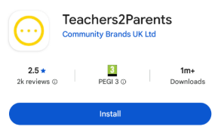
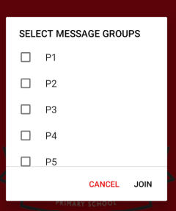
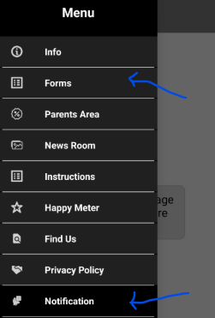
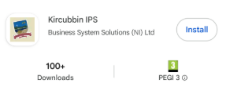
School Money App
Please download the School Money App – ‘Teachers2Parents’
It will be used for processing payments for:
DINNERS
WRAP AROUND CARE (including bookings)
AFTER-SCHOOL CLUBS
TRIPS
SWIMMING
HEALTHY SNACK
Remember to sign-up for Free School Meals if you’re entitled.
Even if you are not using it regularly it makes a difference to the money school is allocated.
School App
Please download our School App – ‘Kircubbin IPS’
It will be used for:
WEEKLY UPDATES
REMINDERS/MESSAGES
REPORTING ABSENCES
Remember to select the appropriate year group/s

Slide 20
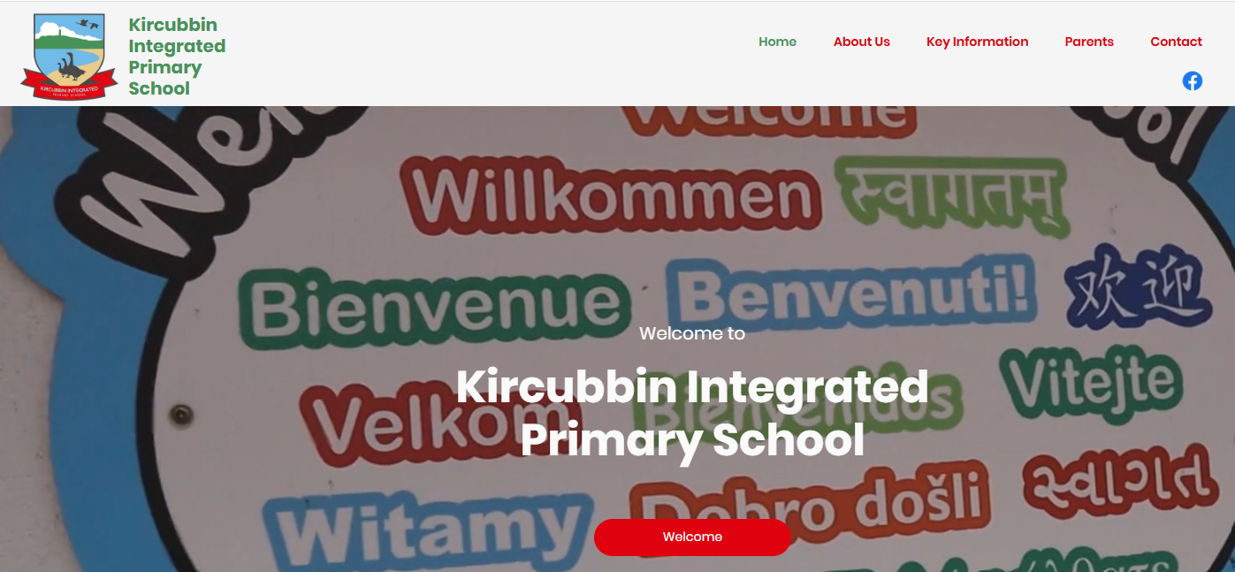

School Website
Our school website contains a wealth of useful information for parents/carers, including school policies, weekly updates, support resources, Accelerated Reader guidance, KIPS Care & Breakfast Club information and updates on school life.
School Facebook
Our school Facebook page provides regular updates on school life, including photographs of learning activities, educational visits, special events and pupil achievements.

Slide 21

Please do not hesitate to talk to me about any issues/concerns you have throughout the year!
I am here to help and support your child.
I hope your child has a great year in P6. ☺

