Slide 1
Parents’ Information Session 2023

Slide 2
AIMS
Learning to Love,
Loving to Learn
INTRODUCTION
SETTING THE SCENE
AGENDA FOR THE YEAR
FORGING LINKS

Slide 3
School Vision
Learning to Love,
Loving to Learn
At Kircubbin Integrated Primary School we firmly believe that we all need to love and be loved. Through core integrated principles of equality, faith and values, parental involvement and social responsibility we aim to ensure all within our school community are valued, respected and loved. In learning to love, our children can love to learn and achieve their full potential.

Slide 4
School Aims
Learning to Love,
Loving to Learn
At KIPS we aim to create a loving, happy and stimulating environment where pupils can learn effectively by…
Equality
Catering for the needs of each individual.
Faith and Values
Ensuring that people from all faiths and none, are respected, acknowledged and accepted as valued members of the school community through mutual understanding.
Parental Involvement
Effectively partnering with parents and the wider community in supporting our children.
Social Responsibility
developing a sense of responsibility and a belief that we can all make a positive difference with ourselves and others, locally, internationally and to the planet.

Slide 5
Drop Off/Collections
Learning to Love,
Loving to Learn
Drop-off arrangements remain the same - No pupils to be in school before 8.45am. All pupils should be left off at the main entrance where they will be directed to their classroom. Parking is only available for P1 parents or as agreed in other exceptional circumstances. This is to encourage pupil independence.
Staggered pick-up times.
Pick-up for P3- 2pm.

Slide 6
SCHOOL EQUIPMENT
Bringing resources to school:
On a daily basis your child should bring:
Packed break/lunch
Filled water bottle
Reading book
School bag
A coat
Over the ear headphones- send in, when you’re able to, labelled headphones. These will stay in school for individual iPad use.
**All items of clothing and equipment should be labelled.

Slide 7
PE
PE- all pupils will be required to wear outdoor games kit (white polo shirt, black/red shorts and/or black tracksuit bottoms/leggings, red hoodie and trainers) for the whole school day.
From week beginning 4th September.
P3 PE day is Wednesday.

Slide 8
Homework- Parental Involvement SDP Focus
Homework completion- In recent years we have reduced the amount of homework set to focus on elements of learning (spellings, tables and reading).
Teacher records from last year highlighted that many pupils had low levels of homework completion and that overall performance in Friday tests had fallen.
In addition, the data from standardised testing last year showed that many of the pupils with low levels of homework completion underperformed in the areas of spelling, number facts and reading comprehension.

Slide 9
Homework- Parental Involvement SDP Focus
This year as part of our SDP we want to address the underperformance as our data also shows that those pupils who consistently meet their targets on Accelerated Reader, complete their homework and complete tasks on Mathletics achieve scores in line with or above their ability and regularly improve in their reading.

Slide 10
Accelerated Reader data from the P5 class in the 2022-23 academic year.
Pupil A met all 5 reading targets with significant improvements in their reading while Pupils B didn’t meet their reading targets. The difference between the two pupils reduced from 2 years and 4 months to 2 months in one academic year.
Pupil C and Pupil D started the year around the same level in their reading and were in the same reading group. Pupil C met one of their reading targets while Pupil D met all of their reading targets. At the end of the year the gap between the two pupils was 2 years and 3 months and Pupil D had progressed to two reading groups above Pupil C.
Last year in P3-7 only 53% of all AR targets were met.
Pupil A | 6 years 8 months | 7 years 7 months | 8 years 1 month | 8 years 3 months | 9 years 2 months
Pupil B | 9 years | 9 years 2 months | 9 years 7 months | 9 years 5 months | 9 years 4 months
Pupil C | 8 years 7 months | 9 years 3 months | 8 years 7 months | 8 years 9 months | 8 years 9 months
Pupil D | 8 years 5 months | 9 years 11 months | 10 years 1 month | 10 years 10 months | 11 years

Slide 11
Homework- Parental Involvement SDP Focus
How we will address this:
Nightly completion of home spellings and tables.
Increased levels of reward for completion of AR and Mathletics.
Continue to inform parents of pupils who have achieved less than 75% of their target during a testing period.
Class records of homework completion kept and reported on during parent teacher interviews and annual report.
Parent Workshops/Video tutorials shared.

Slide 12
Homework- Parental Involvement SDP Focus
How you can support your child:
Encouraging your child to complete their homework.
Checking and signing completed homework.
Encouraging reading (reading to/reading with your child, questioning your child about what they’ve read etc.)
Establishing a homework routine- E.g. Eat the frog first
Creating the right environment- E.g. Removing distractions, technology etc.
Rewards at home?

Slide 13
Homework- Parental Involvement SDP Focus
AR targets, Mathletics activities and homework will be differentiated and therefore achievable for all pupils.
At KIPS we want to develop a love of learning and if your child is finding an element of their homework difficult and/or stressful we encourage you to speak to the class teacher.

Slide 14
Homework- Parental Involvement SDP Focus
P3 Homework consists of:
Spellings and Tables
Guided Reading
Independent Reading (Accelerated Reader)
Mathletics
Weekly written Numeracy/Literacy/Topic homework.

Slide 15
Homework
Titles / Year Groups | 1 | 2 | 3 | 4 | 5 | 6 | 7
Time Spent per night | Up to 20mins | Up to 20mins | Up to 25-30mins | Up to 25-30mins | Up to 30-40mins | Up to 40-45mins | Up to 40-45mins
Spellings and Tables | N/A | N/A | Daily (learning and written) | Daily (learning and written) | Daily (learning and written) | Daily (learning and written) | Daily (learning and written)
Guided Reading/Accelerated Reader | As reading emerges, Reading 4 nights | Reading 4 nights | Reading 4 nights (15mins) | Reading 4 nights (15mins) | Reading 4 nights (20mins) | Reading 4 nights (20mins) | Reading 4 nights (20mins)
Written | Literacy/Numeracy (To include topic related homeworks) |  | Literacy/Numeracy (To include topic related homeworks)
Learning | Reinforcement of letters, words and numbers | Sounds and tricky words | Tables | Tables | Tables | Tables | Tables
Mathletics | (Term 2) | Tasks set weekly 1000pt target per week

Slide 16
Accelerated Reader Video

Slide 17
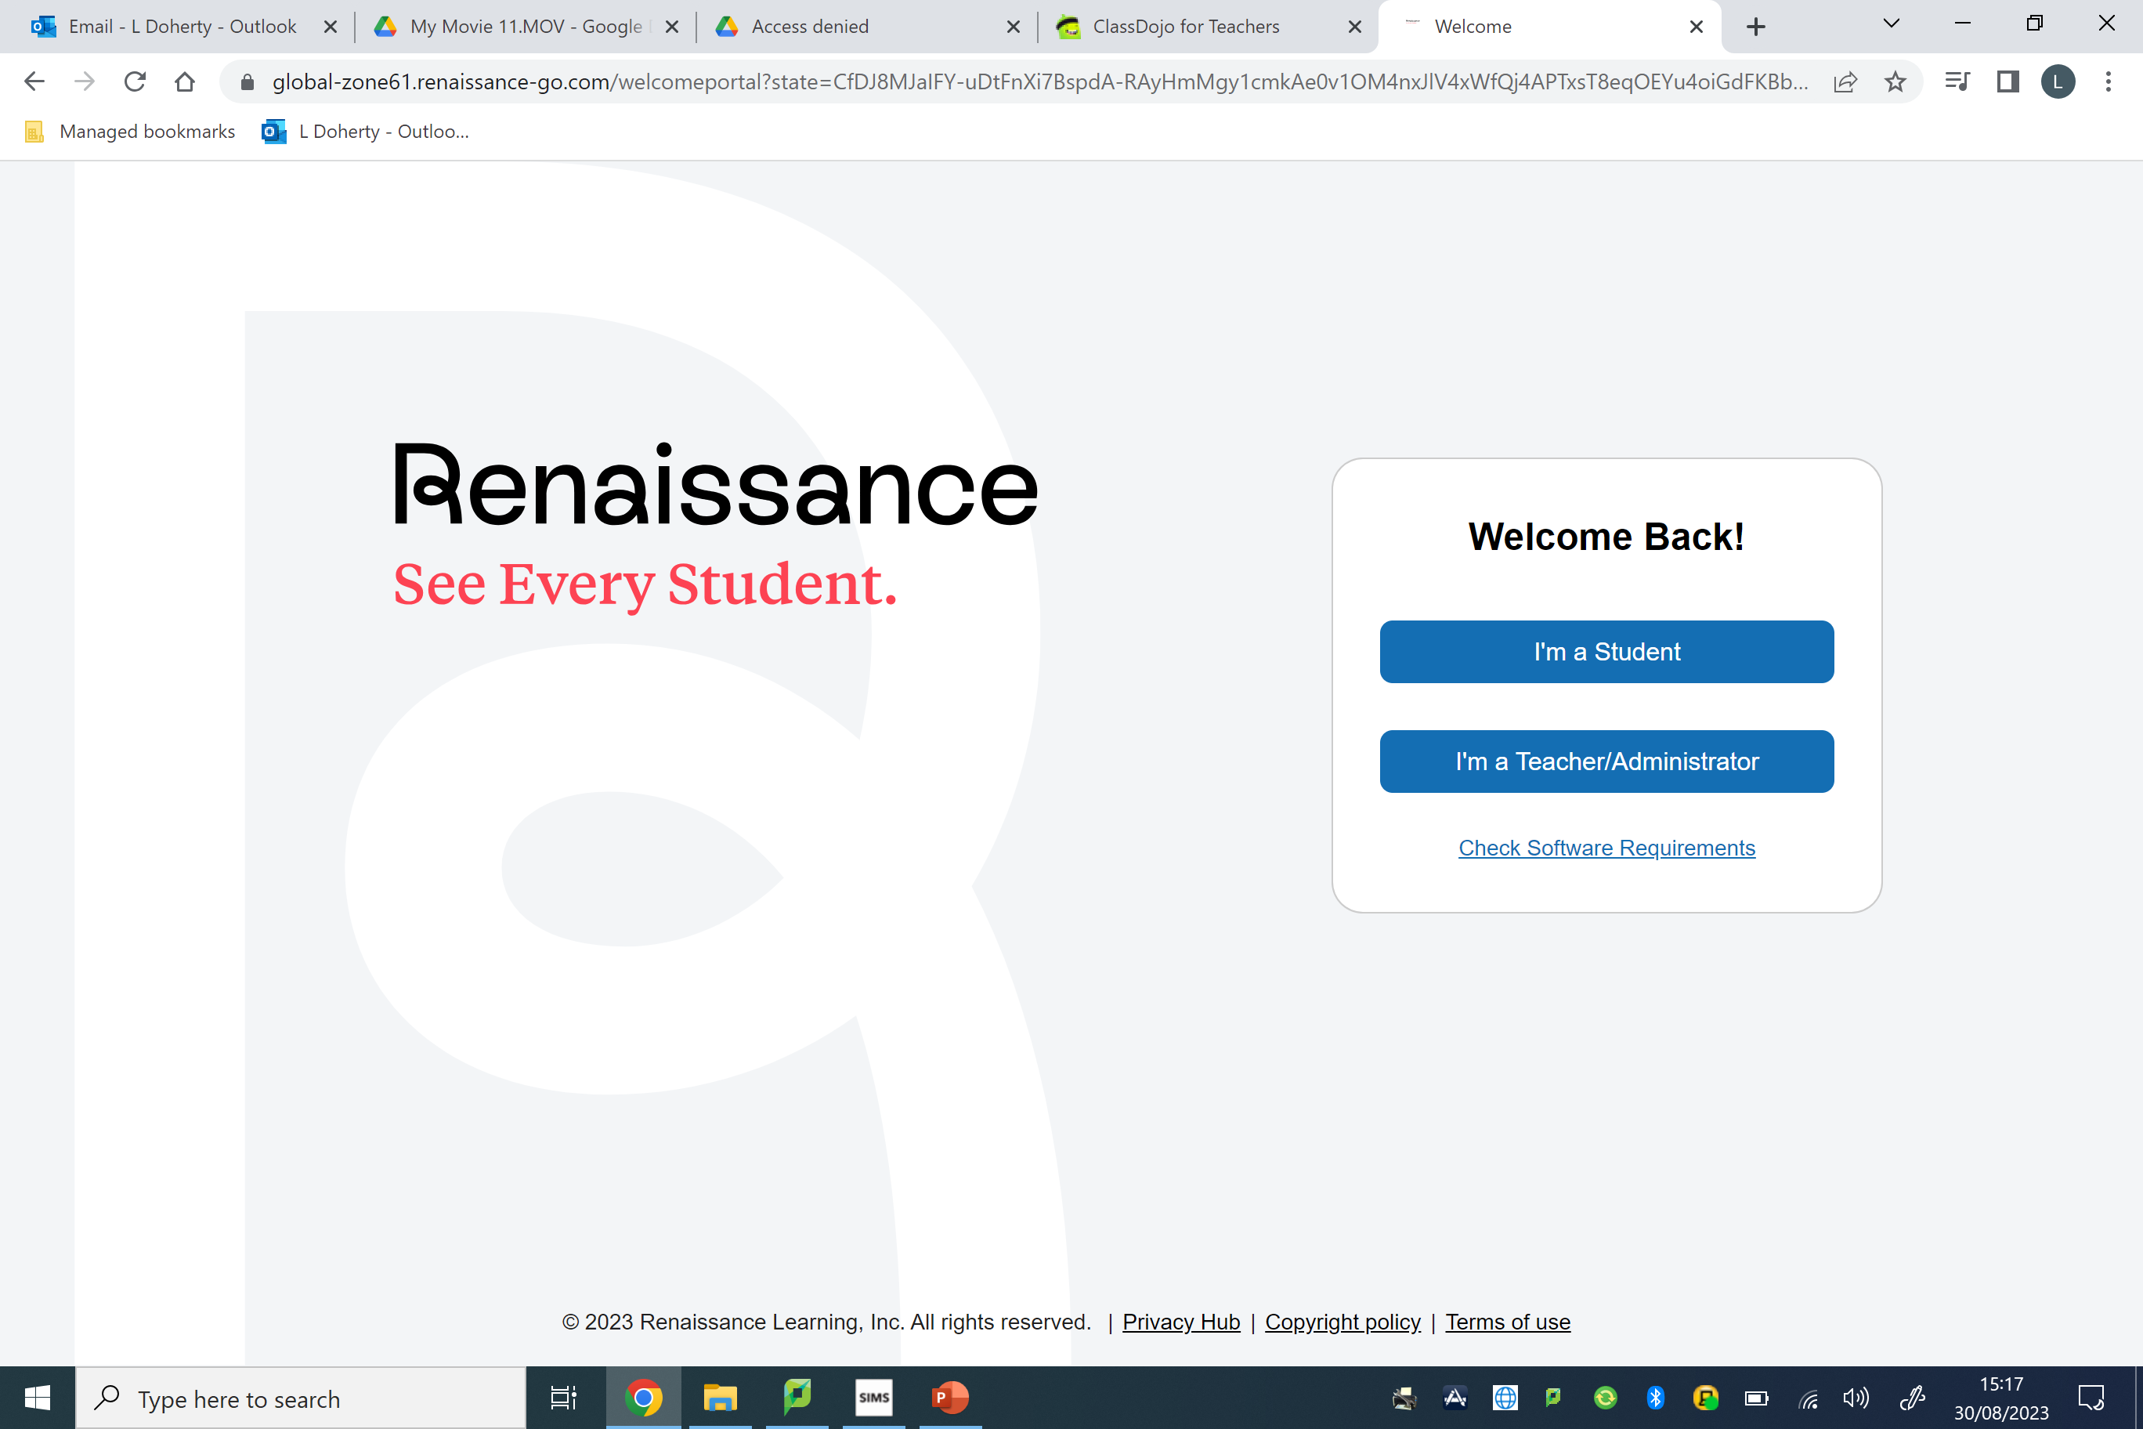
How to Sign up for Notifications

Slide 18
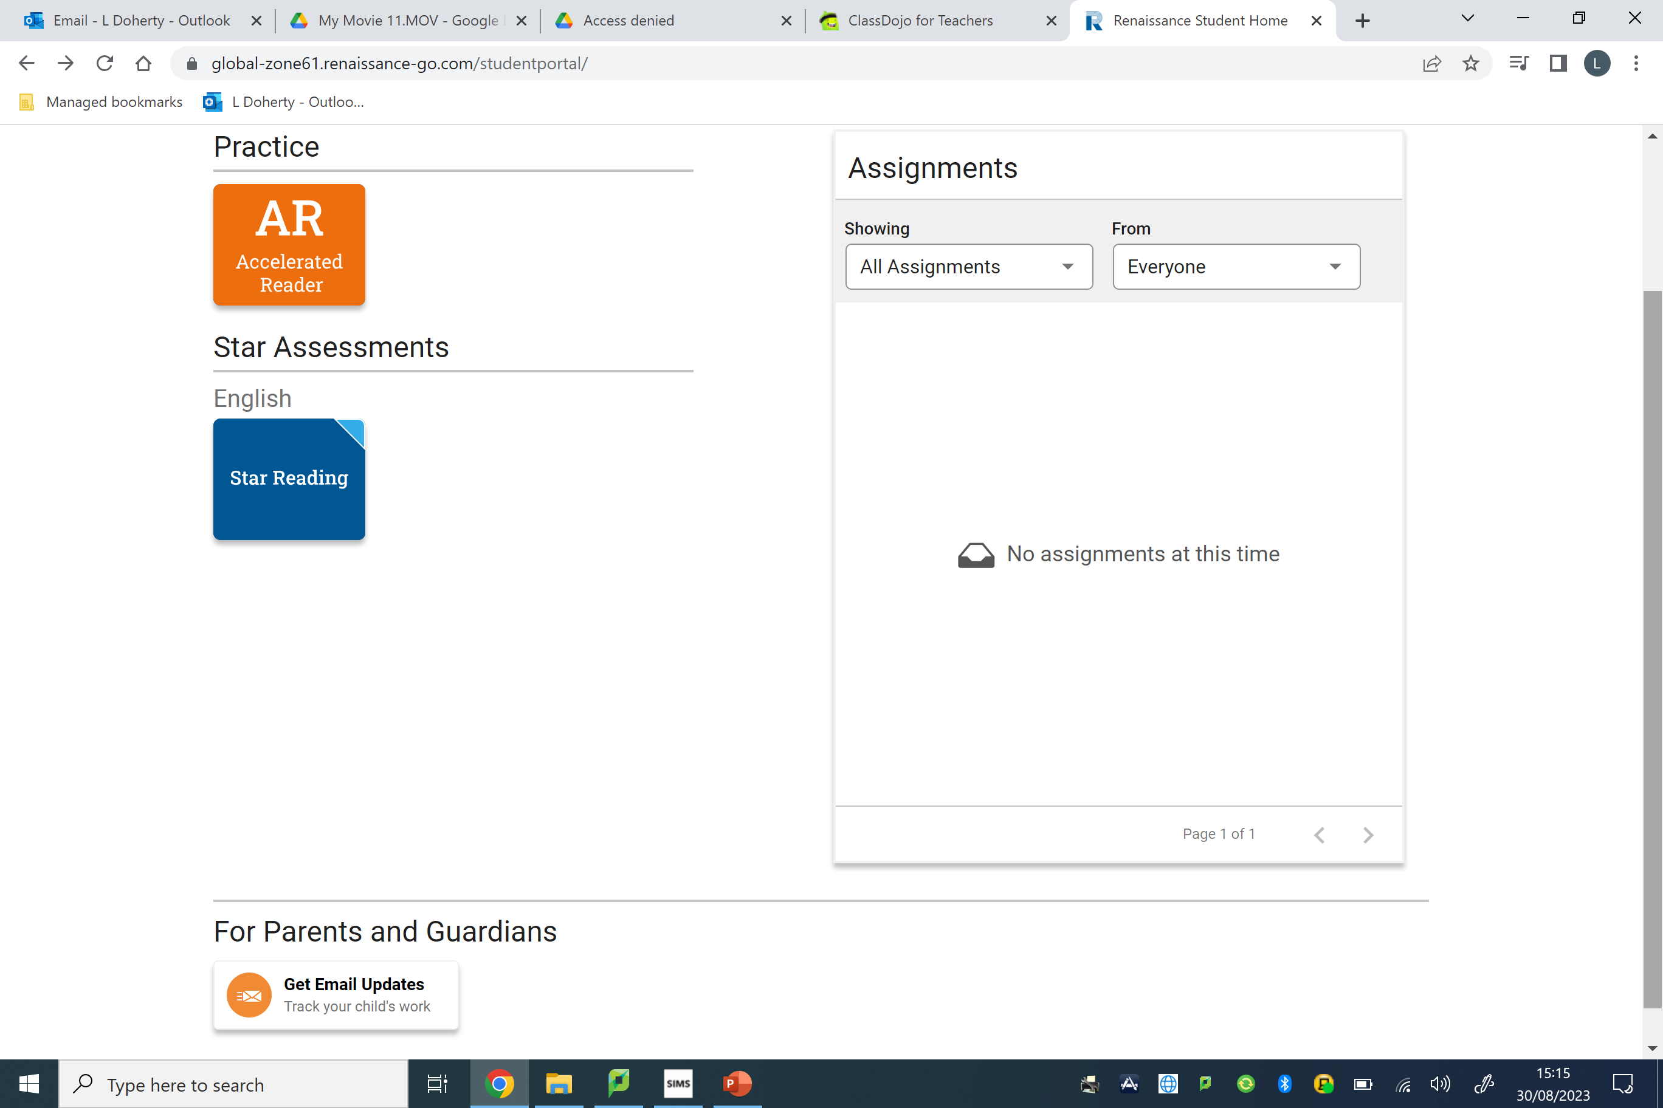
How to Sign up for Notifications

Slide 19
ACCELERATED READER P3-7
P3 is the first year of Accelerated Reader for pupils.
Pupils complete a STAR READER test. This gives pupils a score and a corresponding box that they choose from.
Books chosen are at your child’s level.
Please encourage reading as much as possible. When they have finished their book they take a quiz.
Pass a quiz = sticker on bookmark
10 stickers = prize from prize box

Slide 20
ACCELERATED READER P3-7
Pupil targets – child specific and achievable. Targets set throughout the year (approx. every 8-9 weeks). All pupils are expected to meet their target.
STAR Test.
AR letters will be sent home to parents of any pupil achieving under 75% of their target.
The number of targets reached at the end of the year will be recorded on the annual report.

Slide 21
Mathletics
P2-7 pupils will complete activities on Mathletics on a weekly basis in class and for homework.
The aim for the week is to complete the assigned homework activities.
Every time a pupil achieves 1000 points in a week on Mathletics they will be entered into a prize draw.
Gold Certificate for 20 weeks of 1000 points.
Mathletics Badge for 25 weeks of 1000 points.

Slide 22
DATES FOR YOUR DIARY
Parental Consultations–
23rd -27th October 2023
26th February – 1st March 2024
We will be encouraging face to face meetings. Phone calls may be arranged if preferred.

Slide 23
DATES FOR YOUR DIARY
KIPS After School Clubs Dates 2023/24
Further dates and details of clubs will follow shortly.
Term 1 clubs will commence week beginning 2nd October.

Slide 24
SCHOOL APP
Information will be communicated primarily via the school app. This includes consent forms, absence forms and links to parent surveys/useful websites.
Remember to change your class selection on the school app so that you get the notifications relevant to the class your child is in.
To do this:
Select Notifications
Select Settings
Select Message Group- P3

Slide 25
SCHOOL MONEY APP
School is a cash-free zone.
Please download the School Money app
The school money app will be used for processing payments for:
DINNERS - £2.60 – Remember to sign-up for Free School Meals if you’re entitled. Even if you are not using it regularly it makes a difference to the money school is allocated.
WRAP AROUND CARE (including bookings)
AFTER-SCHOOL CLUBS
TRIPS

Slide 26
ASSESSMENT
PTE/PTM STANDARDISED TESTS (every May)
CLASS ASSESSMENTS- Weekly Friday tests
Comments in books
AR STAR TESTS (every 9 school weeks approx)
Books will be sent home to parents (half-termly) to be signed

Slide 27
COMMUNICATION
Contact the office to:
Inform class teacher of any changes to collection arrangements (bus etc.).
Inform teacher of illness (or via school app).
Inform school of any changes to personal details.
Arrange an appointment or phone call with a class teacher.
Inform school if you require dual communication.

Slide 28
Attendance
It is important that your child is in school whenever possible. If your child is suffering from fever like symptoms they should remain at home until 48 hours after symptoms have ceased.
Parents will receive a letter home informing them if their child’s attendance has fallen below the EA target of 95% (more than one day every four weeks). The Education Welfare Officer will also track any attendances that fall below this percentage.
Holidays in Term Time
Holidays during term time are discouraged by the school. Parents are reminded of the effect that absence can have on a pupil’s potential achievement.

Slide 29
HEALTH AND WELL-BEING
A summary of important child protection and safeguarding policies will be sent home later this term.
MyHappyMind.
Mood tracker.

Slide 30
HEALTHY EATING
As a school we promote healthy eating and a balanced diet. Please note the following –
Nut free zone (please do not send any cakes into school for sharing).
Water bottles (should contain water only – advice from dentist)
P3 receive healthy snack.
Items such as crisps, sweets and chocolate should be kept to a minimum in lunchboxes.

Slide 31
IMAGINE IF
As a school we recognise the benefit of our weekly counselling sessions and have decided to continue with the service at a cost to the school.
This will consist of two weekly school counselling sessions providing support to two individual pupils each half-term.
If you feel that your child would benefit from these sessions please complete a referral form online https://imagineif.org.uk/primary-schools

Slide 32
Internet Safety
Many children are using video sharing platforms, social media and messaging apps such as:
Whatsapp groups etc.
Snapchat, Tiktok etc.
Online gaming
Youtube
Issues can arise when using these apps. It is so important to monitor what your child does online.
You can download the ‘Safer Schools NI’ app for guidance on parental controls, making devices safer and how these apps are used.

Slide 33
ADMINISTRATION
The following will be sent home with your child at the start of the school year. Please return as soon as possible.
PERMISSION LETTERS
MEDICAL INFORMATION
DATA CAPTURE FORM
COMMUNICATION- CONTACTS UPDATED IF NECESSARY

Slide 34
KIPS +
KIPS+ is the name of our school Parents’/Teachers’ Association (PTA).
If you would like to be involved please phone the school office for further details.

Slide 35
CLASS INFORMATION
P3 team consists of Mrs Downes, Mrs Doherty and Mrs Burtonwood.
A Classroom Charter is created with the pupils at the start of the year.
Transition to Key Stage 1
Independence
In P3 we encourage independence in the classroom, for example :
- getting homework, notes, letters or money out of folders themselves
- becoming more independent in class and having a go.
Transition to Activity Based Learning
Pupils will now have Activity-Based Learning every Wednesday & Thursday afternoon.

Slide 36
Positive Behaviour
Rewards
Class dojo
Dojo Champion (certificate).
10 dojo points (badge for
reaching 10, 20 or 30 points).
Table Champions
Golden Time
Stars of the Week (certificate) awarded in assembly
Sanctions
Traffic light system
Notes:
Golden time – meet their weekly target, get 3 thumbs up out of 5.
Stars of the week – Mr Irvine will give a target.
Traffic lights – All pupils on green, yellow for a warning, red for thinking time.

Slide 37
LANGUAGE AND LITERACY
Guided Reading
Your child’s reading record and guided reading book/books will be sent home each night. Please ensure your child brings them to school each day so they are able to complete their guided reading in class.
Listening to Story Books/Class Novels
- In P3 children enjoy having stories read to them. They listen to Enid Blyton’s Collection of the Far Away Tree novels and other stories.

Slide 38
Writing
Writing: Each half term has a specific focus when it comes to writing.
You will be able to see your child’s writing when books come home.
At this stage in P3, what I’m looking for in your child’s writing:
Capital letters, full stops and finger spaces.
Neat writing/consistent letter formation.
Increasingly spelling more common words correctly.

Slide 39
USING MATHS
Numeracy in P3
We cover number, money, shape, measures and handling data.
Number - Begin with numbers within 20. This includes Number Stories, consolidation of numbers to 20, adding/subtracting to 10 and then 20.
As the year progresses we cover numbers and processes to 30, 50 and then 100, including vertical and horizontal addition to 100.
Mental Maths.
Mathletics- can be used inside and outside of school.
Will be used for homeworks.

Slide 40
USING MATHS
Number Stories
Number Story - A number story is a given number and all of its addition and subtraction facts that can be generated.
A specific number story will be covered each week in class. You will see this in your child’s weekly tables.
Your child will be aiming to understand the relationships within each number: - 3+2 = 2+3 - 6 + __ = 10 - 9+1=10 1+9=10 10-9=1 10-1=9
It would be of great benefit to your child if you could spend some time on number stories with your child when they come home as weekly tables.
You could leave out a different missing number each time.
Encourage quick recall of facts.
This will really help your Childs' mental maths skills.
Notes:
At the beginning of P3 we study number stories.

Slide 41
TOPICS
Term 1 – Let’s Celebrate
Term 2 – Safe and Sound
Term 3 – Whatever the Weather
Term 4 – Bugs. Birds and Beasts
Term 5 – Houses and Homes

Slide 42
HOW YOU CAN HELP
Look over classwork books when they are sent home.
Keep in touch with any issues you feel we should know about.
Encourage Independence
In class we are encouraging independence.
You could encourage this at home e.g. allow your child to pack their own school bag.
Resilience
We encourage resilience in P3 so your child knows:
It’s good to have a go or have a try yourself.
It’s ok to make mistakes.

